Slide 1
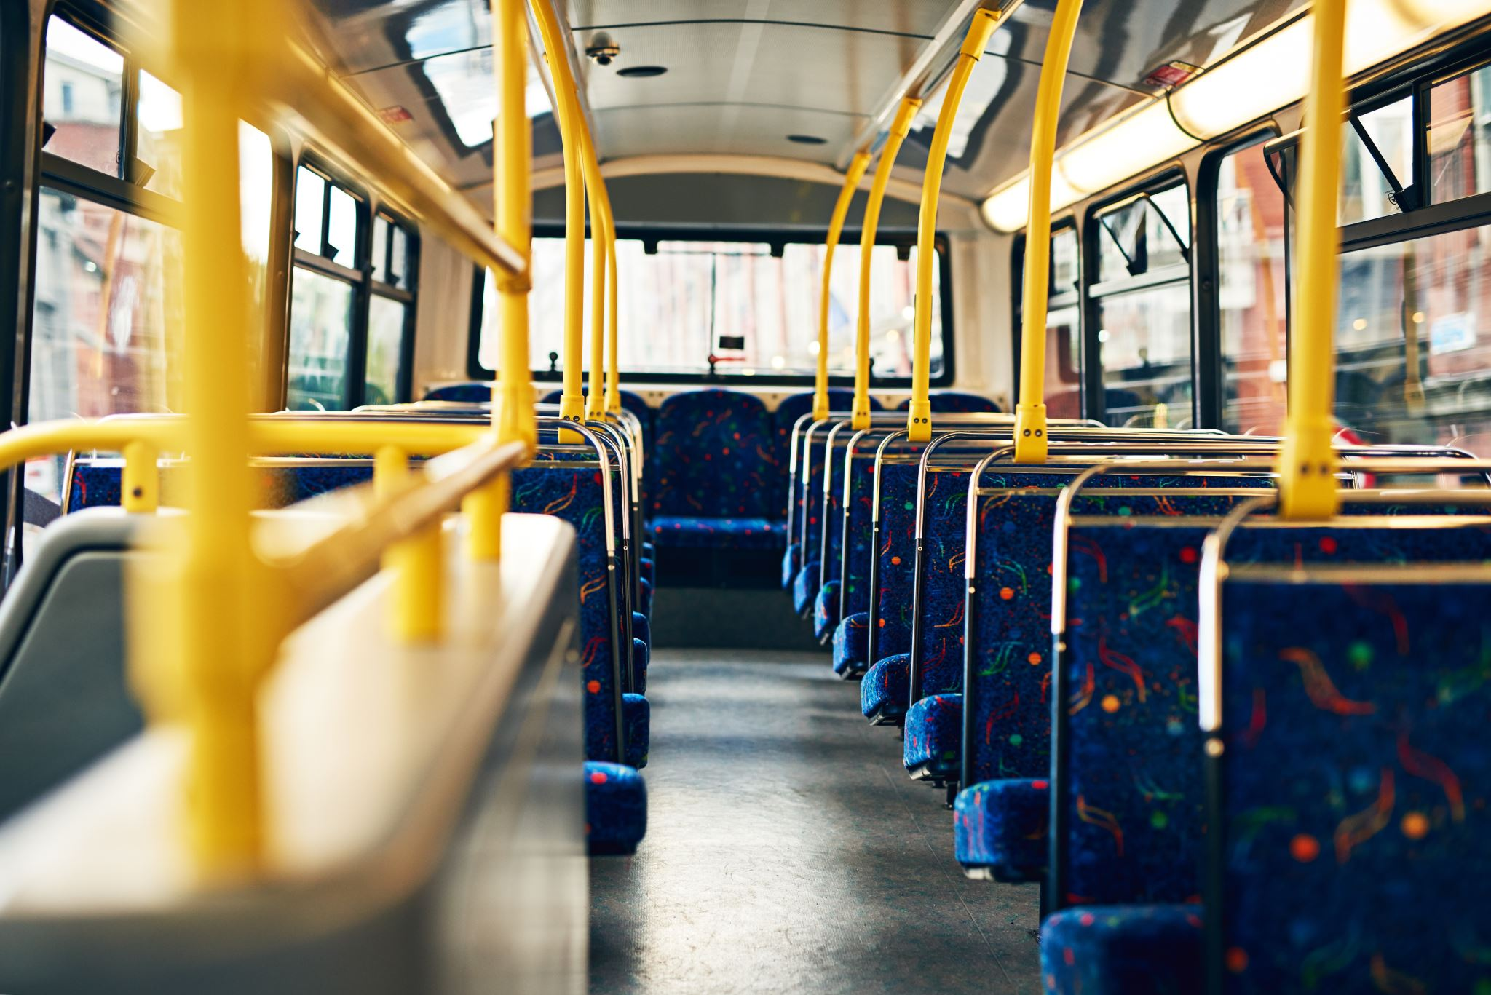
ATAL INDORE CITY TRANSPORTATION
Hitesh Pahwa, Dhanyata Mehta, Sameera Kodukulla

Slide 2
INDORE PUBLIC TRANSPORATOIN
Bus
Metro Rail
Taxis
Auto Rickshaw
Bicycle Sharing
Private Vehicles

Slide 3
THE BRT SYSTEM
The iBus is designed to provide faster and more reliable transportation services to commuters in Indore, with dedicated bus lanes, pre-paid smart cards for fare payment, and other features aimed at reducing travel time and improving the overall transportation experience.
ADVANTAGES | DISADVANTAGES
Faster travel times – Dedicated bus lanes and bus stops | Limited coverage – Does not cover all parts of the city
Reduced congestion – Reduced cars on the road helping traffic congestion | Capacity constraints – Cannot handle large volumes of passengers
Cost effective – Cheaper and be implemented easily | Dependence on buses – Breakdowns, maintenance issues, lack of drivers
Increased accessibility – Better access to public transportation | Lack of flexibility – Operates only on a fixed route and schedule

Slide 4
OBJECTIVE-
The main objective of the project is to determine the optimal number of buses that are required to transport passengers from Rajiv Gandhi bus stop to Niranjanpur Square bus stop and vice-versa for peak and non-peak hours.

Slide 5
DATA FROM THE CASE
Maximum number of buses in the system
46 buses
Maximum bus speed for peak hours
15km/h
Maximum bus capacity
51 passengers
Bus operational hours
6:00 am to 10:00 pm
Peak hours
7:30 am to 11:30 am
Distance between the start and end points
11.57 km
Maximum bus coverage allowed
1200 km per week(~171 km per day)
12-hour shift drivers
8:00 am to 8:00 pm
8-hour shift drivers
6:00 am to 2:00 pm

Slide 6
ORIGIN- DESTINATION DEMAND MATRIX (PEAK HOURS)

Slide 7
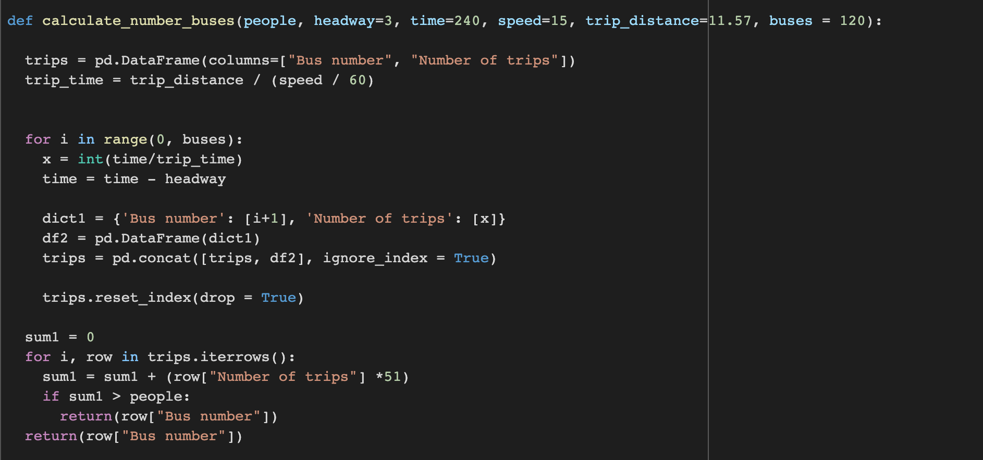
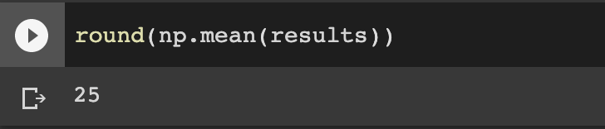
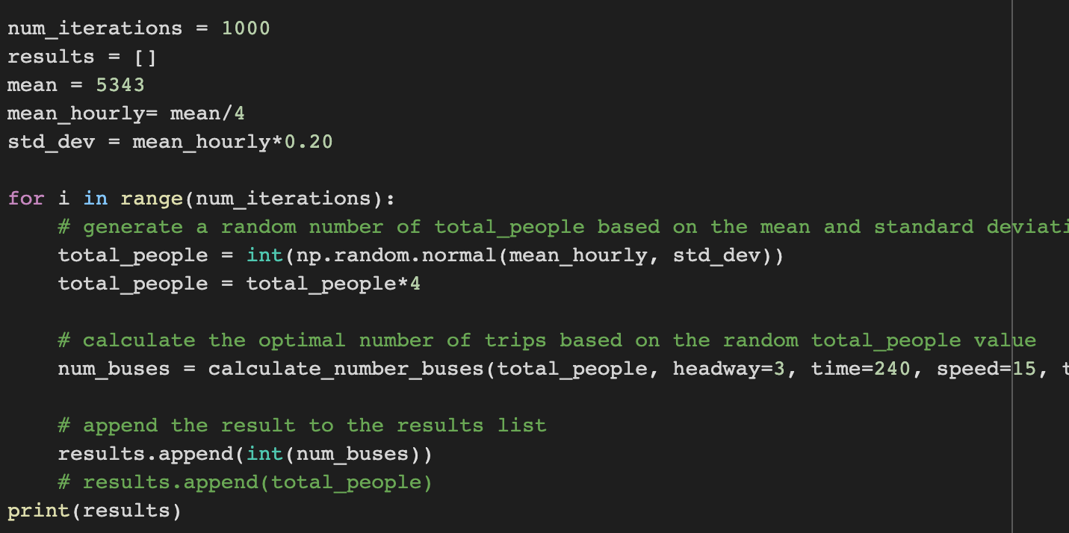
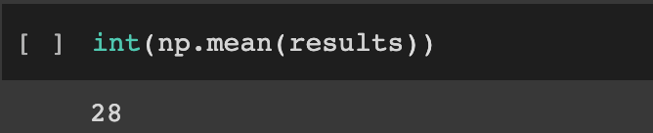
MONTE CARLO SIMULATION
NUMBER OF BUSES FROM ONE SIDE-R.G. TO N.S.
NUMBER OF BUSES FROM ONE SIDE- N.S TO R.G.

Slide 8
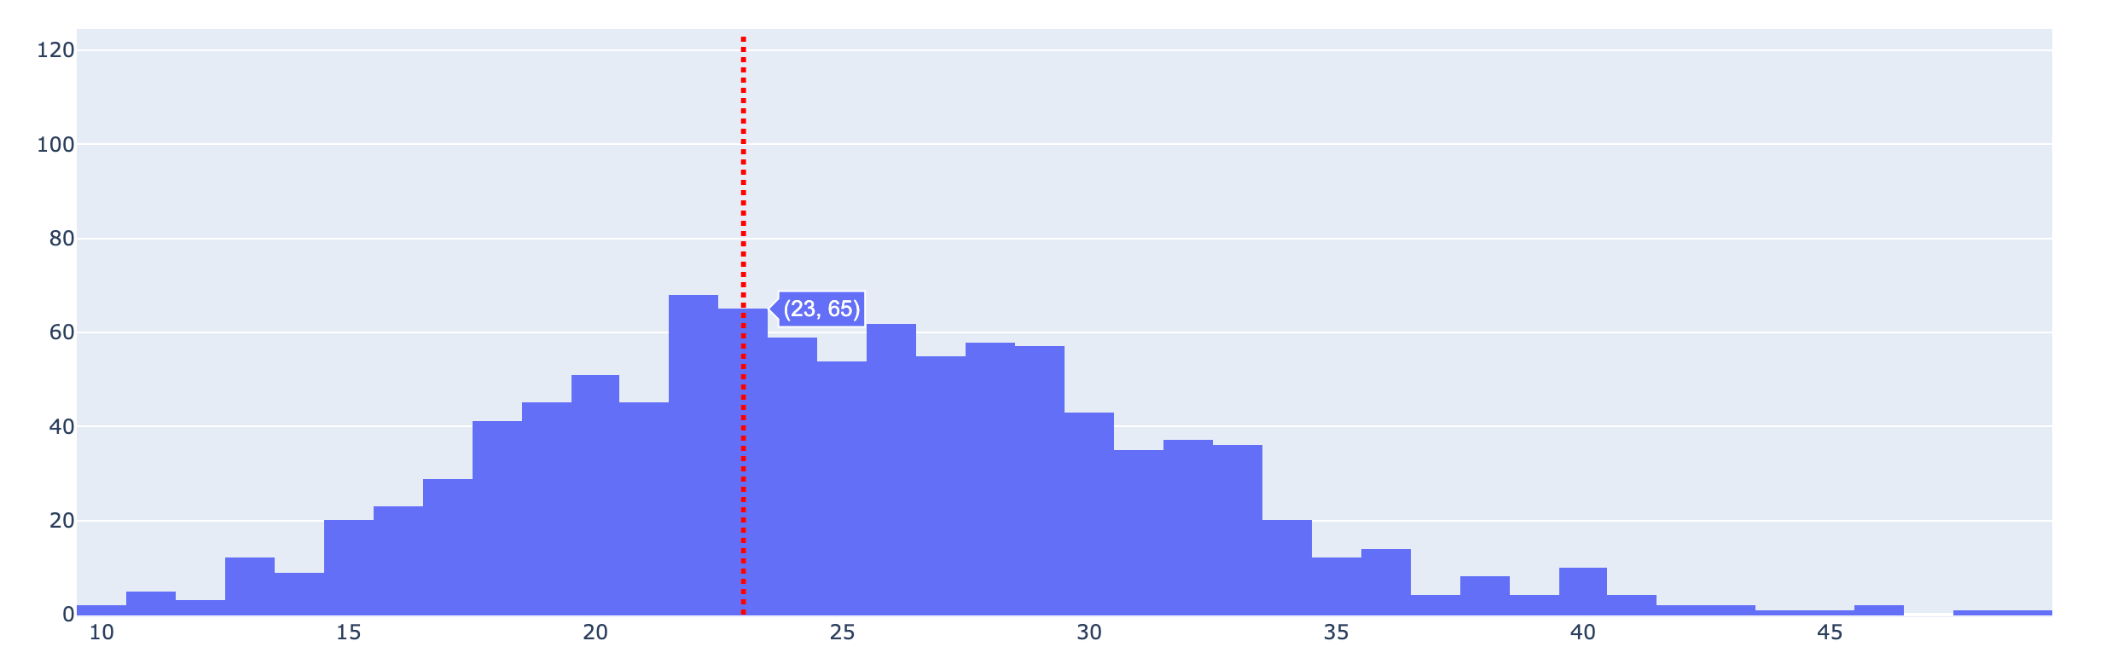
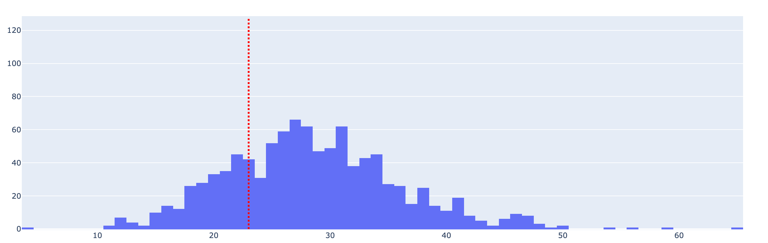
DEMAND MET GIVEN BUSES IN SYSTEM
FROM R.G TO N.S
Number of times the system was able to achieve demand with 46 buses - 425.
FROM N.S TO R.G.
Number of times the system was able to achieve demand with 46 buses - 244.

Slide 9
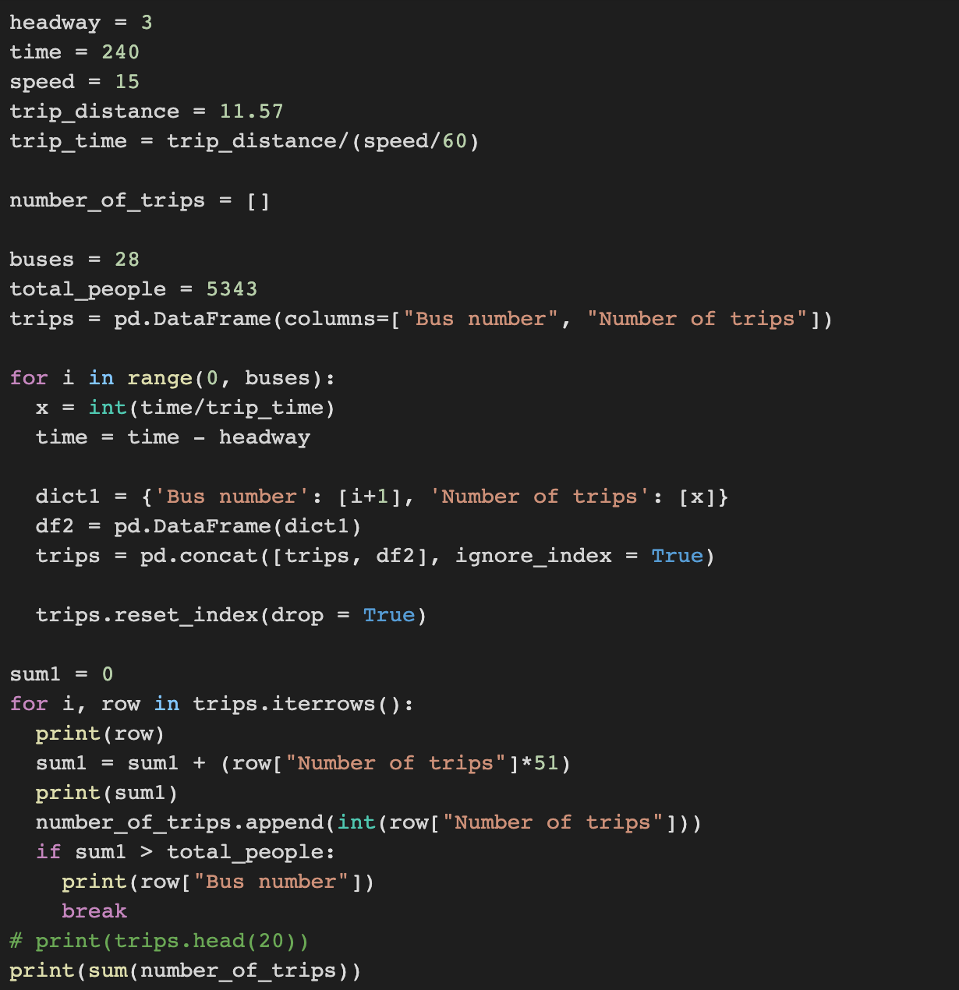
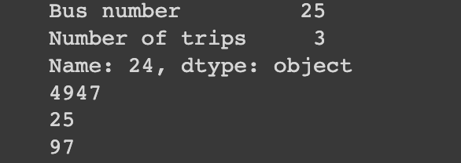
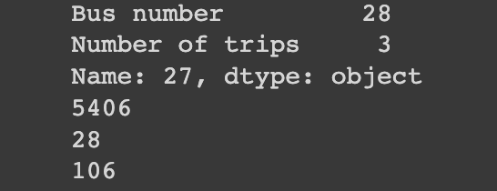
TOTAL TRIPS TAKEN
TRIPS FROM R.G TO N.S
TRIPS FROM N.S TO R.G.

Slide 10
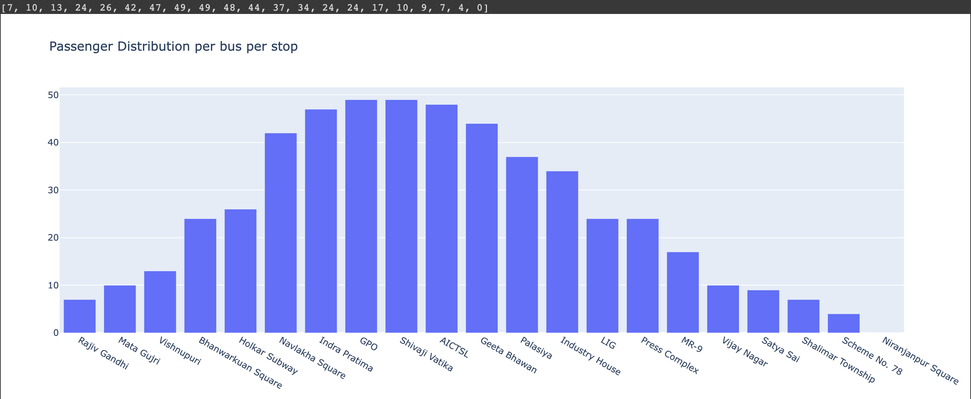
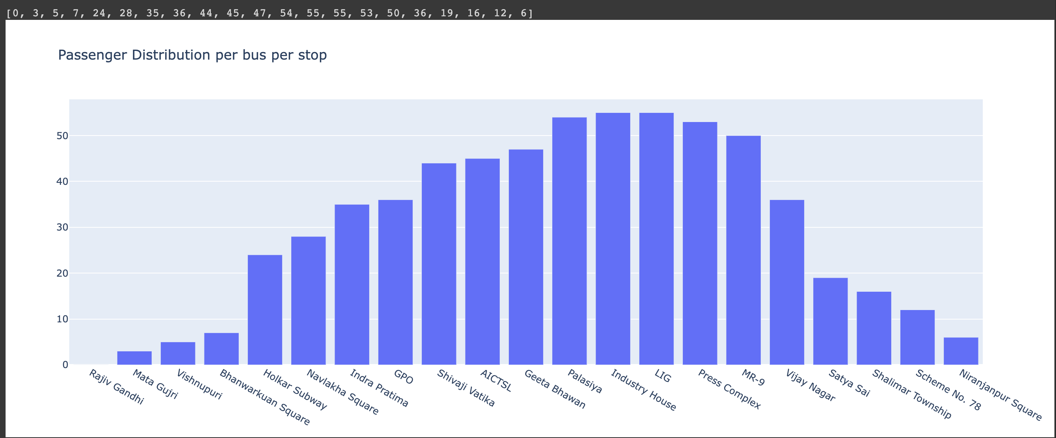
PASSENGER DISTRIBUTION
FROM R.G TO N.S
FROM R.G TO N.S
FROM N.S TO R.G

Slide 11
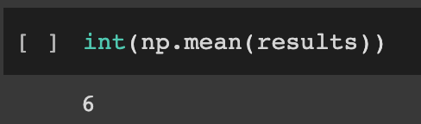
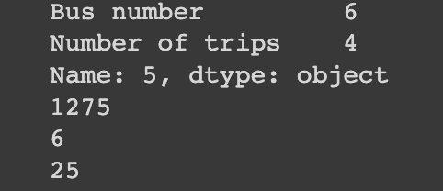
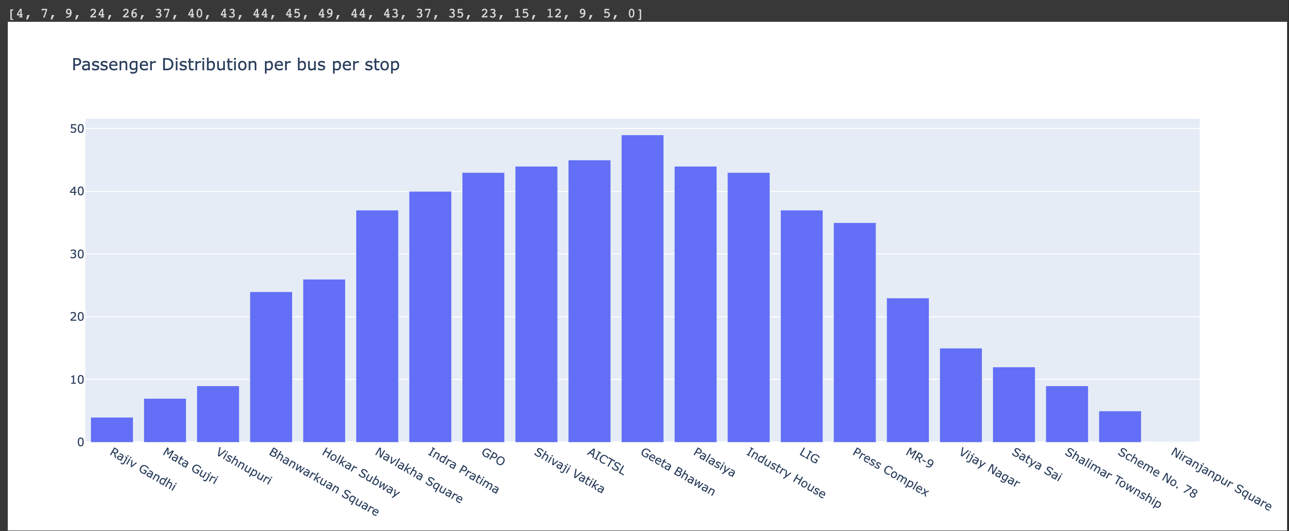
NON- PEAK DEMAND SUMMARY (GOING)

Slide 12
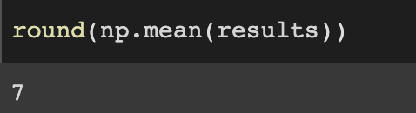
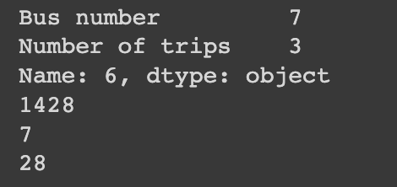
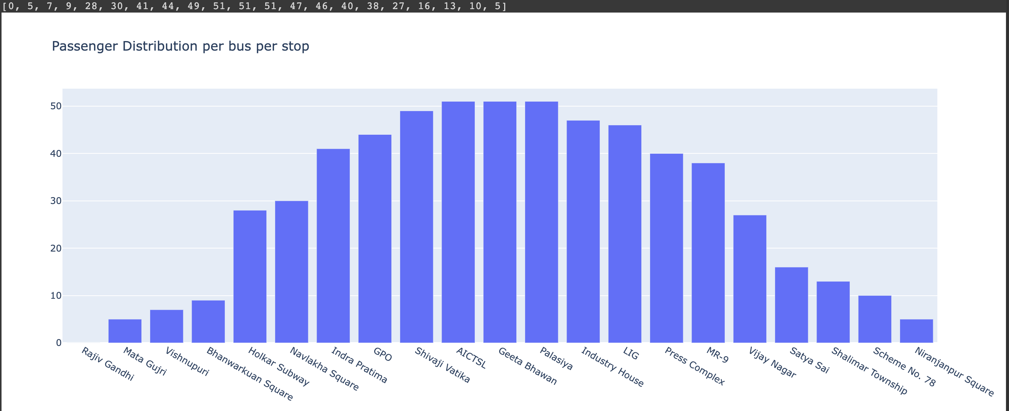
NON- PEAK DEMAND SUMMARY (COMING)

Slide 13
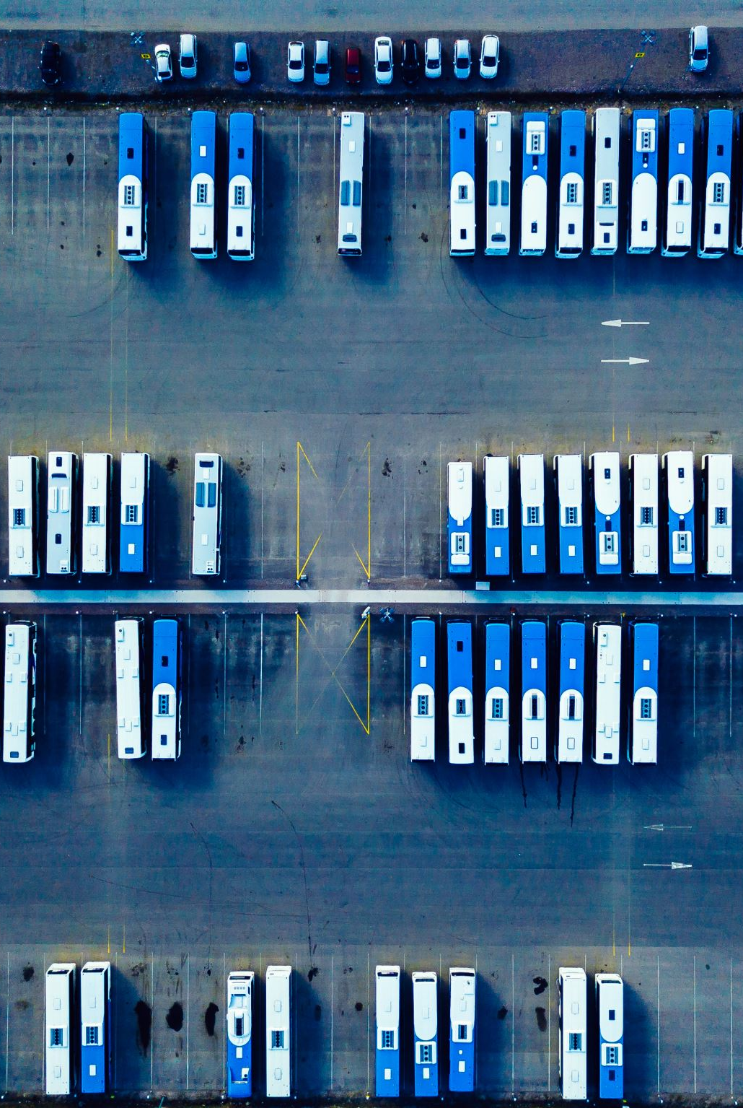
INSIGHT-
Both rounds for peak hours require more than 46 buses.
Going from Rajiv Gandhi to Niranjanpur square requires around 50 buses
Coming from Niranjanpur square to Rajiv Gandhi requires around 56 buses
To meet demand, we will have to increase the number of buses
Both rounds of Non- peak hours are fully met with less than 15 buses being in use.
We have equal number of buses running from both sides because we cannot assume that one side will always have higher demand so to find a solution with lower risk, we will take the higher number of buses.

Slide 14
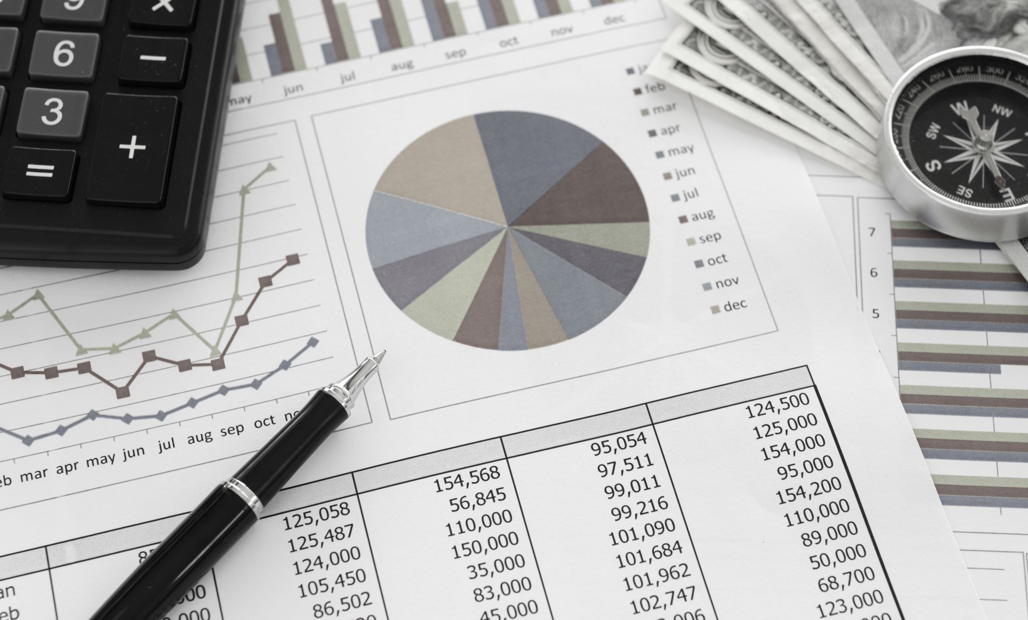
COST ANALYSIS

Slide 15
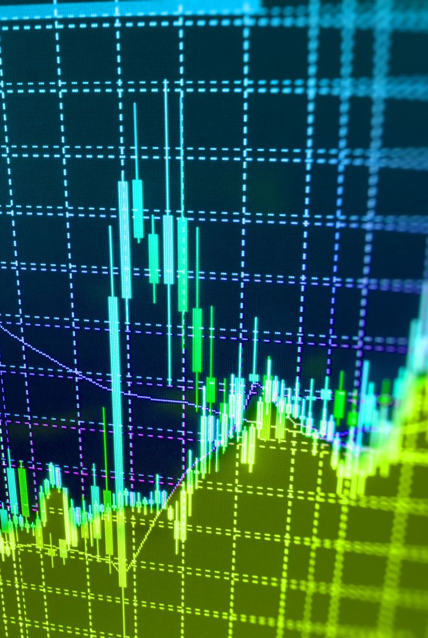
FUEL PRICE CALCULATION
DISTANCE COVERED BY 1 BUS (AVERAGE) : 21.9KM (PEAK) – 106 rounds
23.14KM (NON-PEAK)- 28 rounds
CNG COST : Rs 56/kg
FUEL COST PER DAY :
(distance traveled per day) /
(mileage of the bus per kg of CNG) * (price of CNG per kg) = Rs245.28
Rs259.168
TOTAL FUEL PRICE OF 56 BUSES OPERATING IN PEAK HOURS= Rs13,735.68
TOTAL FUEL PRICE OF 14 BUSES OPERATING IN NON-PEAK HOURS= Rs3,628.25

Slide 17

APPENDIX

Slide 18


QUEUING SYSTEM
NIRANJANPUR SQUARE
7:33 am
8:15 am
7:36 am
7:30 am
RAJIV GANDHI
The first bus from each side leaves at 7:30 am and reaches the end at 8:15 am
The bus is added to the back of queue and will have to wait for it’s turn to avoid collision.

Slide 19
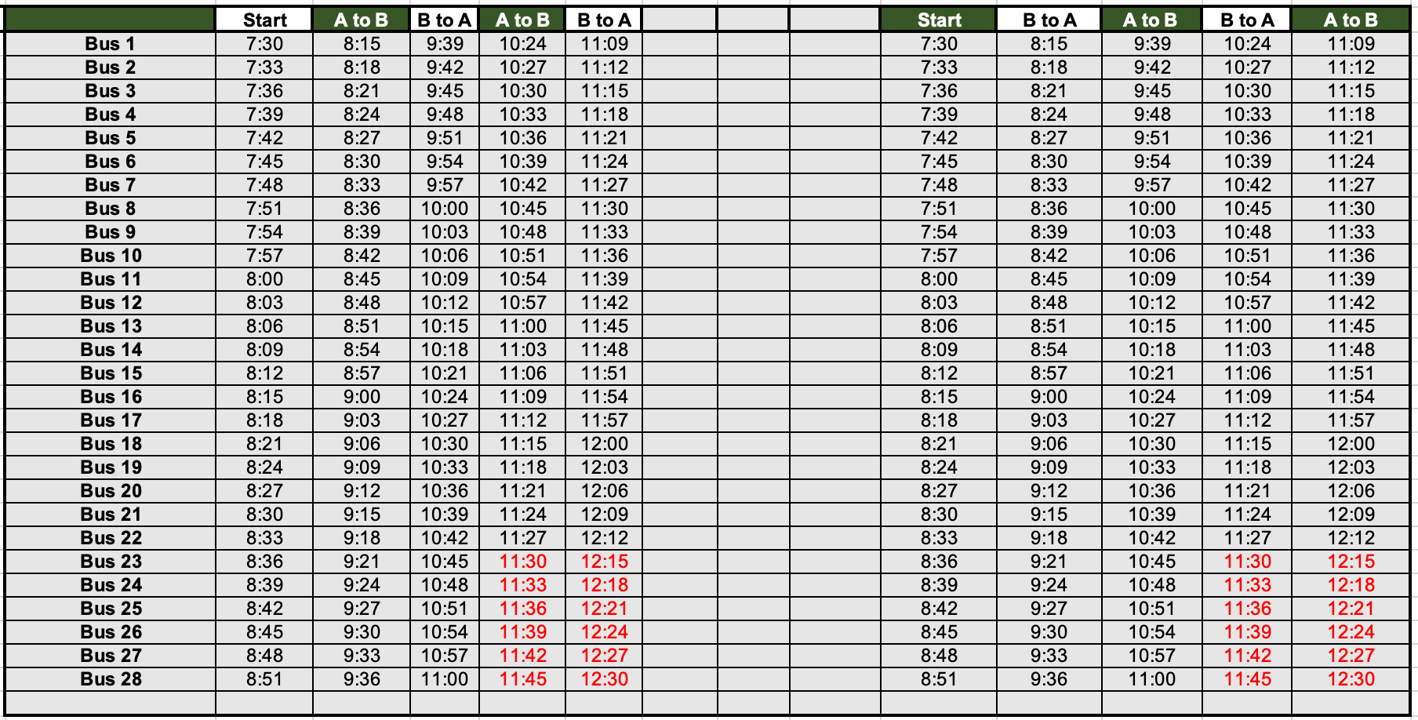

Slide 20
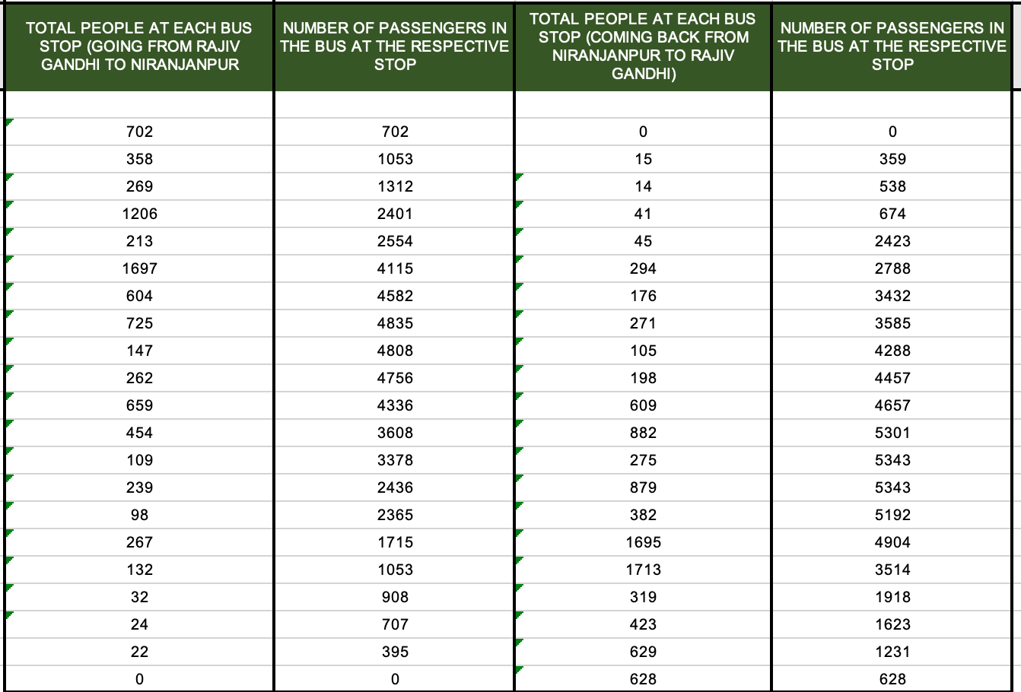
CUMULATIVE SUM

